Slide 1
Network Robustness
Daniel Chapi Alejo - Graph Analytics

Slide 2
Resistance against attacks and random failures
-Random Failures
-Betweenness Attacks
-Closeness Attacks
-Hubs Attacks
Random Networks
Scale-free Networks

Slide 3
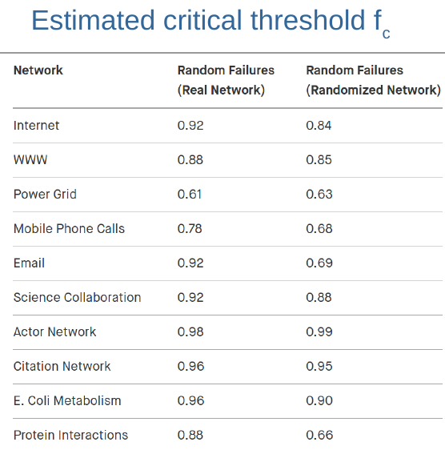
Critical thresholds
For each type of attack, exists a critical threshold of nodes that if deleted, would break the network. It varies significantly between random networks and scale-free ones.
The denser a network is, the higher the critical threshold.

Slide 4
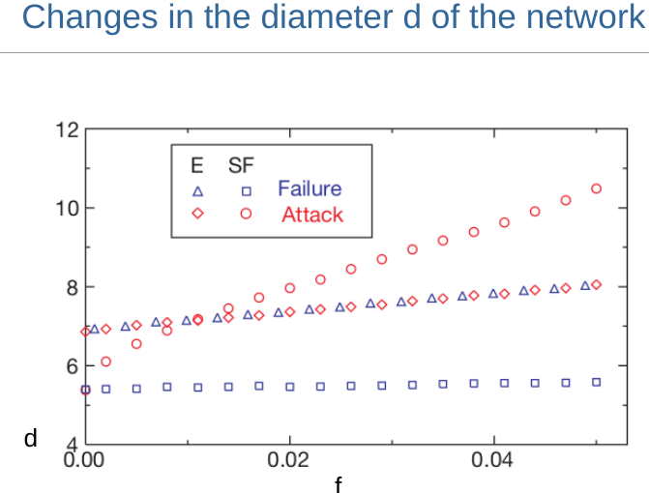

Slide 5
The WWW and the Internet - Scale-free Networks
Average performance of the Internet is reduced by 2 <- 1% of most connected nodes removed
The internet loses Integrity <- 4% of most connected nodes removed

Slide 6
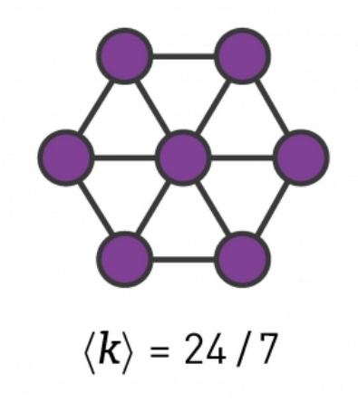
Preventing failures?
If we want to design a topology for a network that is robust enough we would simply need to make a hub with all the neighbors having the same degree. but for large networks this would be too expensive to implement and most of the times unrealistic because each connection has a cost.
Another possibility would be to be prepared against cascade failures preventing the failures to spread across all the network at an early stage of the malfunction.

